Slide 1
functions

Slide 2
What is C Function?
A function is a block of statements, which is used to perform a specific task. Suppose you are building an application in C language and in one of your program, you need to perform a same task more than once. So in such scenario you have two options –
A) Use the same set of statements every time you want to perform the task.
B) Create a function, which would do the task, and just call it every time you need to perform the same task.
Using option (b) is a good practice and a good programmer always uses functions while writing codes.
C function contains set of instructions enclosed by “{ }” which performs specific operation in a C program.

Slide 3
Uses of C Function
To improve the readability of code.
Improves the reusability of the code, same function can be used in any program rather than writing the same code from scratch.
Debugging of the code would be easier if you use functions as errors are easy to be traced.
Reduces the size of the code, duplicate set of statements are replaced by function calls.

Slide 4
Types of Functions
Predefined standard library functions – such as puts(), gets(), printf(), scanf() etc – These are the functions which already have a definition in header files (.h files like stdio.h), so we just call them whenever there is a need to use them.
User Defined functions – The functions which we can create by ourselves.

Slide 5
3 Aspects of each C Function
Function declaration or prototype – This informs compiler about the function name, function parameters and return value’s data type.
Function call – This calls the actual function
Function definition – This contains all the statements to be executed.
C functions aspects | syntax
function definition | Return_type function_name (arguments list) { Body of function; }
function call | function_name (arguments list);
function declaration | return_type function_name (argument list);

Slide 6
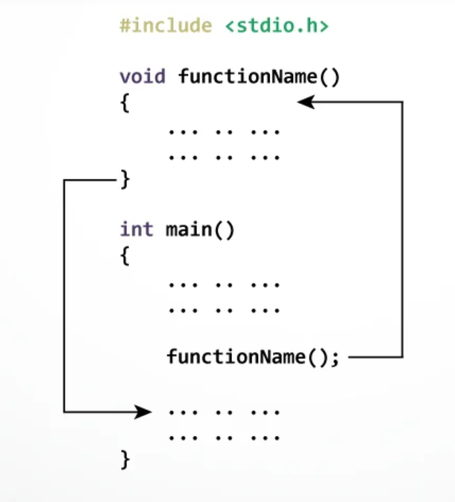
Working of function

Slide 7
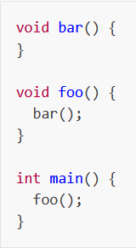
Function call and function call stack

Slide 8
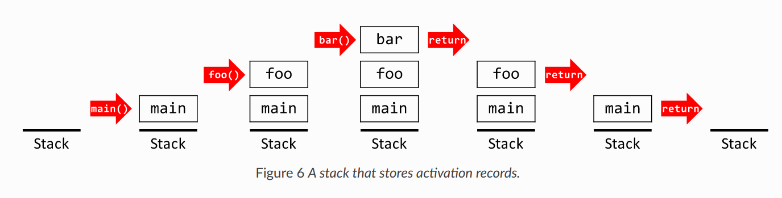
Function call and Function call stack

Slide 9
Function prototype (declaration)
Every function in C programming should be declared before they are used. These type of declaration are also called function prototype. Function prototype gives compiler information about function name, type of arguments to be passed and return type.
Syntax of function prototype
return_type function_name (type(1) argument(1),...., type(n) argument(n));
In the above example, int add(int a, int b); is a function prototype which provides following information to the compiler:
1. name of the function is add()
2. return type of the function is int.
3. two arguments of type int are passed to function.

Slide 10
Function call
Control of the program cannot be transferred to user-defined function unless it is called invoked.
Syntax of function call
function_name (argument(1),....argument(n));
In the above example, function call is made using statement add(num1,num2); from main(). This make the control of program jump from that statement to function definition and executes the codes inside that function.
A function can be called with or without an argument.

Slide 11
Function definition
return_type function_name (argument list)
{
Set of statements – Block of code
}
return_type: Return type can be of any data type such as int, double, char, void, short etc.
function_name: It can be anything, however it is advised to have a meaningful name for the functions so that it would be easy to understand the purpose of function just by seeing it’s name.
argument list: Argument list contains variables names along with their data types. These arguments are kind of inputs for the function. For example – A function which is used to add two integer variables, will be having two integer argument.
Block of code: Set of C statements, which will be executed whenever a call will be made to the function.

Slide 12
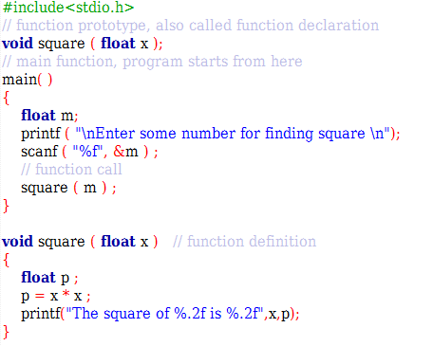
Sample Program
As you know, functions should be declared and defined before calling in a C program.
Function “square” is called from main function.
The value of “m” is passed as argument to the function “square”. This value is multiplied by itself in this function and answer is printed.

Slide 13
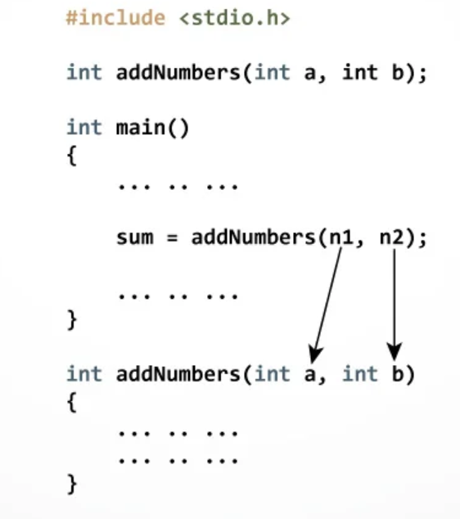
Passing arguments to a function

Slide 14
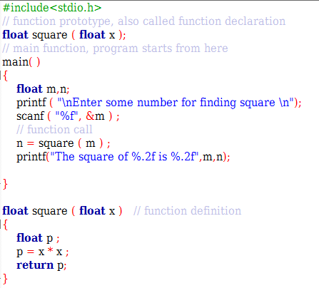
return statement
Return statement is used for returning a value from function definition to calling function.
Syntax of return statement
return (expression);
For example:
return a;
return (a+b);

Slide 15
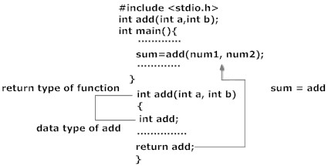
return statement
In this example, value of variable add in add() function is returned and that value is stored in variable sum in main() function. The data type of expression in return statement should also match the return type of function.

Slide 16
Types of parameters
With respect to function, two types of parameters used are:
1. Actual Parameters – Parameters specified in function call
2. Formal Parameters – Parameters specified in function definition
void main()
{
int num1;
display(num1); //num1 is actual parameter
}
void display(int para1) //para1 is formal parameter
{
}

Slide 17
Types of user defined functions
For better understanding of arguments and return type in functions, user-defined functions can be categorised as:
Function with no arguments and no return value
Function with no arguments and return value
Function with arguments but no return value
Function with arguments and return value.

Slide 18
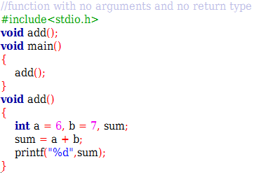
Function with no arguments and no return value

Slide 19
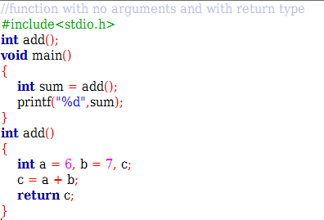
Function with no arguments and return value

Slide 20
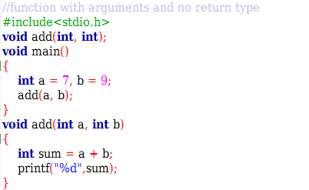
Function with arguments and no return value

Slide 21
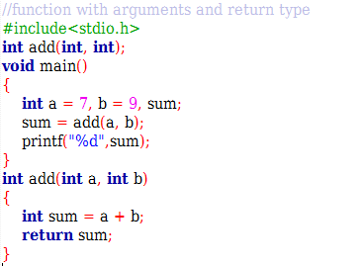
Function with arguments and return value

Slide 22
Scope and lifetime of variables
Scope of variables: It means in what part of the program the variable is accessible. In what part of the program the variable is accessible is dependent on where the variable is declared.
Two types:
Local variables
Global variables
Lifetime of variables: Life time of any variable is the time for which the particular variable exists in memory during running of the program.

Slide 23
Local variables
Declared inside the body of the function are called local variables for that function.
Cannot be accessed outside the function in which they are declared.
Thus, local variables are internal to the function in which they are defined.
Variables declared in main( ) function or any user defined function are local for the corresponding function.
Not initialized automatically.
Scope:
Local variable can be used only in the function in which they declared.
Lifetime:
Lifetime of a local variable starts when control enters the function in which it is declared and it is destroyed when control exists from the function.

Slide 24
Global variables
Declared outside any function definition is called as global variable.
Are accessible by all the functions in the program, i.e., all the functions in the program can share global variable.
Initialized automatically by default value.
Scope:
These variables are globally accessed from any part of the program. They are declared before main function.
Lifetime:
Global variables exist in the memory as long as the program is running. These variables are destroyed from the memory when the program terminates. These variables occupy memory longer than local variables.

Slide 25
Local Variables
Local Variables
These variables are declared inside some functions.
Life time of a local variable is the entire execution period of the function in which it is defined.
Cannot be accessed by any other function.
In general variables declared inside a block are accessible only in that block.
/* Compute Area and Perimeter of a circle */
#include <stdio.h>
float pi = 3.14159; /* Global */
main() {
float rad; /* Local */
printf( “Enter the radius “ );
scanf(“%f” , &rad);
if ( rad > 0.0 ) {
float area = pi * rad * rad;
float peri = 2 * pi * rad;
printf( “Area = %f\n” , area );
printf( “Peri = %f\n” , peri );
}
else
printf( “Negative radius\n”);
printf( “Area = %f\n” , area );
}

Slide 26
Global Variables
Global Variables
These variables are declared outside all functions.
Life time of a global variable is the entire execution period of the program.
Can be accessed by any function defined below the declaration, in a file.
/* Compute Area and Perimeter of a circle */
#include <stdio.h>
float pi = 3.14159; /* Global */
main() {
float rad; /* Local */
printf( “Enter the radius “ );
scanf(“%f” , &rad);
if ( rad > 0.0 ) {
float area = pi * rad * rad;
float peri = 2 * pi * rad;
printf( “Area = %f\n” , area );
printf( “Peri = %f\n” , peri );
}
else
printf( “Negative radius\n”);
printf( “Area = %f\n” , area );
}

Slide 27
Initializing Local and Global Variables
When a local variable is defined, it is not initialized by the system, you must initialize it yourself. Global variables are initialized automatically by the system when you define them as follows −
It is a good programming practice to initialize variables properly, otherwise your program may produce unexpected results, because uninitialized variables will take some garbage value already available at their memory location.
Data Type | Initial Default Value
int | 0
char | '\0'
float | 0.000000
double | 0.000000

Slide 28
Difference
Local Variable | Global Variable
Local variables are declared inside a function, even as arguments. | Global Variables are declared outside any function.
Local Variables cannot be accessed outside the function. | Global Variables can be accessed in any function.
Local Variables are alive only for a function. | Global Variables are alive till the end of the program.
Local Variables are not automatically initialized. | Global Variables are automatically initialized to their default values.
Modification in local variable can be done only inside the function in which it is declared. | Modification in global variable can be done from anywhere.
An added advantage of the local variable is that it makes it easier to debug and maintain the applications, there is nothing to trace. | One cannot be sure in which function it will be modified or when the variable values will be modified, so difficult to trace.

Slide 29
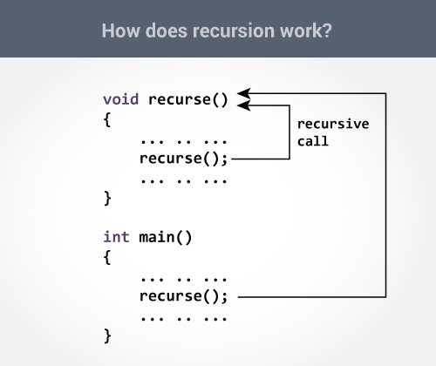
Recursion
A function that calls itself is known as a recursive function. And, this technique is known as recursion.
The recursion continues until some condition is met to prevent it.

Slide 30
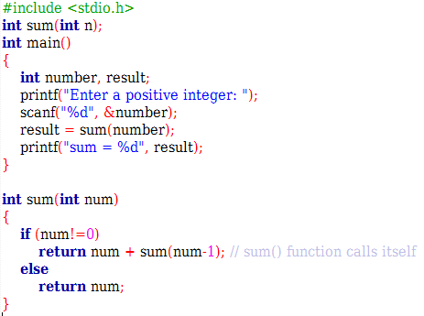
Recursion
Program to find sum of n natural numbers.

Slide 31
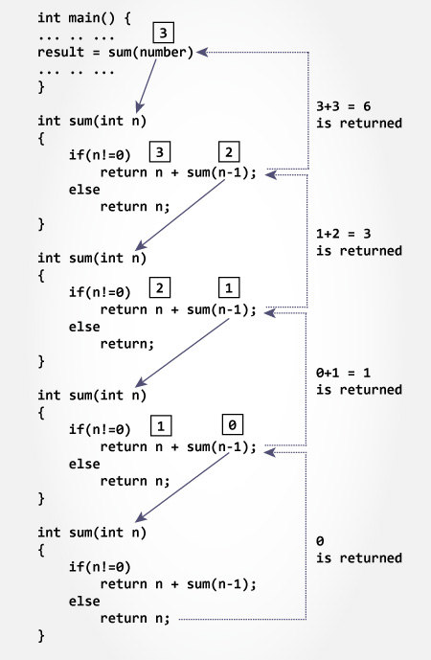
Recursion
Initially, the sum() is called from the main() function with number passed as an argument.
Suppose, the value of num is 3 initially. During next function call, 2 is passed to the sum() function. This process continues until num is equal to 0.
When num is equal to 0, the if condition fails and the else part is executed returning the sum of integers to the main() function.

Slide 32
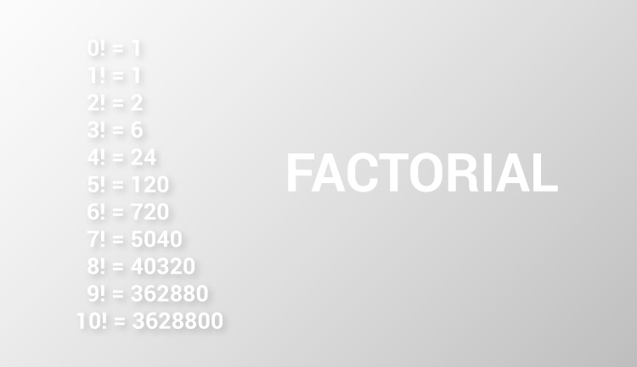
Recursion

Slide 33
Recursion
The factorial of a positive number n is given by:
factorial of n (n!) = 1*2*3*4....n
The factorial of a negative number doesn't exist. And the factorial of 0 is 1.
Suppose the user entered 6.
Initially, the factorial() is called from the main() function with 6 passed as an argument.
Then, 5 is passed to the factorial() function from the same function (recursive call). In each recursive call, the value of argument n is decreased by 1.
When the value of n is less than 1, there is no recursive call.

Slide 34
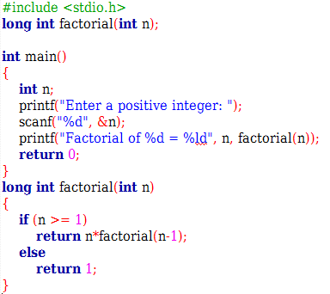
Recursion

Slide 35
How to call functions in a program?
Call by value
Call by reference
Call by value:
In call by value method, the value of the variable is passed to the function as parameter.
Argument values are passed to the function, the contents of the actual parameters are copied into the formal parameters.
The value of the actual parameter cannot be modified by formal parameter.
Different memory is allocated for both actual and formal parameters. Because, value of actual parameter is copied to formal parameter.

Slide 36
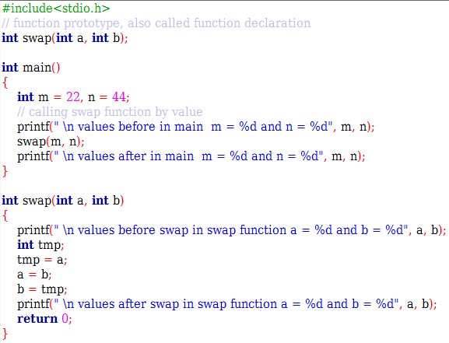
Call by Value
In this program, the values of the variables “m” and “n” are passed to the function “swap”.
These values are copied to formal parameters “a” and “b” in swap function and used.

Slide 37
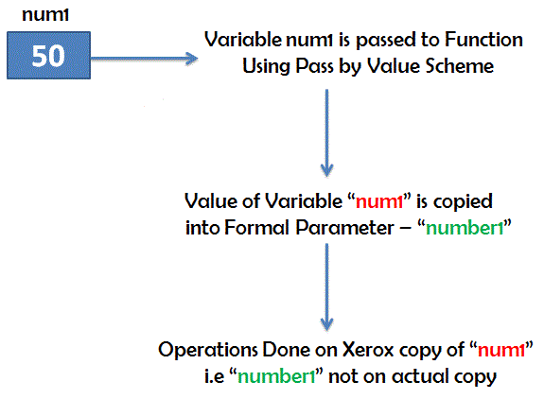
Call by Value
While Passing Parameters using call by value, xerox copy of original parameter is created and passed to the called function.
Any update made inside method will not affect the original value of variable in calling function.
In the above example, m and n are the original values and xerox copy of these values is passed to the function and these values are copied into a, b variable of swap function respectively.
As their scope is limited to only function so they cannot alter the values inside main function.

Slide 38
Call by Reference
In call by reference method, the address of the variable (pointer) is passed to the function as parameter and not the value.
The value of the actual parameter can be modified by formal parameter.
Same memory is used for both actual and formal parameters since only address is used by both parameters.

Slide 39
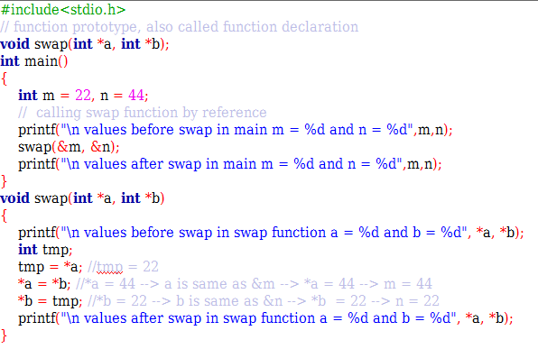
Call by Reference
In this program, the address of the variables “m” and “n” are passed to the function “swap”.
These values are not copied to formal parameters “a” and “b” in swap function.
Because, they are just holding the address of those variables.
This address is used to access and change the values of the variables.

Slide 40
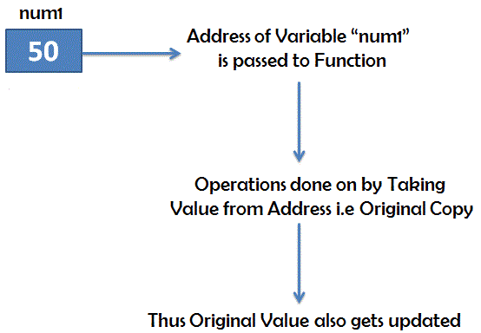
Call by Reference
While passing parameter using call by address scheme , we are passing the actual address of the variable to the called function.
Any updates made inside the called function will modify the original copy since we are directly modifying the content of the exact memory location

Slide 41
Difference
Call by Value | Call by Reference
The value of the variable is passed to the function as parameter. | The address of the variable (pointer) is passed to the function as parameter and not the value.
Argument values are passed to the function, the contents of the actual parameters are copied into the formal parameters. | Instead of copy, the address of the variable is sent to the called function.
The value of the actual parameter cannot be modified by formal parameter. | The value of the actual parameter can be modified by formal parameter.
Different Memory is allocated for both actual and formal parameters. Because, value of actual parameter is copied to formal parameter. | Same memory is used for both actual and formal parameters since only address is used by both parameters.
Creates a new memory location for use within the subroutine. The memory is freed once it leaves the subroutine. Changes made to the variable are not affected outside the subroutine. | Passes a pointer to the memory location. Changes made to the variable within the subroutine affects the variable outside the subroutine.

Slide 42
Recursion vs Iteration
On the basis of | Recursion | Iteration
Basic | Recursion is the process of calling a function itself within its own code. | In iteration, there is a repeated execution of the set of instructions. In Iteration, loops are used to execute the set of instructions repetitively until the condition is false.
Syntax | There is a termination condition is specified. | The format of iteration includes initialization, condition, and increment/decrement of a variable.
Termination | The termination condition is defined within the recursive function. | Here, the termination condition is defined in the definition of the loop.
Code size | The code size in recursion is smaller than the code size in iteration. | The code size in iteration is larger than the code size in recursion.
Infinite | If the recursive function does not meet to a termination condition, it leads to an infinite recursion. There is a chance of system crash in infinite recursion. | Iteration will be infinite, if the control condition of the iteration statement never becomes false. On infinite loop, it repeatedly used CPU cycles.
Applied | It is always applied to functions. | It is applied to loops.

Slide 43
Contd…
Speed | It is slower than iteration. | It is faster than recursion.
Usage | Recursion is generally used where there is no issue of time complexity, and code size requires being small. | It is used when we have to balance the time complexity against a large code size.
Time Complexity | It has high time complexity. | The time complexity in iteration is relatively lower. We can calculate its time complexity by finding the no. of cycles being repeated in a loop.
Stack | It has to update and maintain the stack. | There is no utilization of stack.
Memory | It uses more memory as compared to iteration. | It uses less memory as compared to recursion.
Overhead | There is an extensive overhead due to updating and maintaining the stack. | There is no overhead in iteration.

Slide 44
Array as Parameter in Function
We can pass the whole array as a parameter to the function.
The name of an array is a pointer to the first element of an array.
So, if we pass the name of an array as an argument, we are effectively passing the whole array as an argument.
Naturally, passing an address of an array is call by reference.

Slide 45
#include<stdio.h>
int minarray(int arr[],int size)
{
int min=arr[0];
int i=0;
for(i=1;i<size;i++)
{
if(min>arr[i])
{
min=arr[i];
}
}//end of for
return min;
}//end of function

Slide 46
int main()
{
int i=0,min=0;
int numbers[]={4,5,7,3,8,9};
//declaration of array
min=minarray(numbers,6);
//passing array with size
printf("minimum number is %d \n",min);
return 0;
}

Slide 47
Returning array from Function
C programming language does not allow to return whole array from a function.
However, we can return a pointer to the base address(address of first element of array) of array from a function like any basic data type.
We should not return base pointer of a local array declared inside a function because as soon as control returns from a function all local variables gets destroyed.
If we want to return a local array then we should declare it as a static variable so that it retains it's value after function call.

Slide 48
Thank you!!!

